Slide 1
Conditionals

Slide 2
The If() statement
if (expression){
// code to execute if expression is true
}
else {
// code to execute if expression is false
}

Slide 3
More than One condition
if (expression){
// code to execute if expression is true
} else if (expression 2) {
// code to execute if expression 2 is true
} else {
// code to execute if expression is false
}

Slide 4
Equality
To check if things are equal, we use the equality operator ‘==‘
Examples
if (x == 3)
if (apples == oranges)
if (name == “Joe”)
If they are equal, the result is the Boolean value true and the if statement executes, otherwise it is false and it doesn’t

Slide 5
Using the Boolean data type
You can use a Boolean variable directly in the expression of an if statement
bool isExpired = false;
if (isExpired) {
cout << “The coupon has expired.” << endl;
} else {
cout << “The coupon is valid. “ << endl;
}

Slide 6
A Very Common error
int x = 6;
if (x = 3) {
cout << “It’s true!” << endl;
}
In C++, “true” is any non-zero value
Coding Tip: write these types of expressions as (3 == x) instead

Slide 7
Relational Operators
Relational operators | Description | Example (assume x is 3)
< | a < b means a is less than b | x < 4 is true x < 3 is false
> | a > b means a is greater than b | x > 2 is true x > 3 is false
<= | a <= b means a is less than or equal to b | x <= 4 is true x <= 3 is true x <= 2 is false
>= | a >= b means a is greater than or equal to b | x >= 2 is true x >= 3 is true x >= 4 is false

Slide 8
Logical Operators
Sometimes we want to compare more than one value in an expression.
We can do this by using the logical operators
Logical operator | Description | C++ Syntax
a AND b | Logical AND: true when both of its operands are true. | a && b
a OR b | Logical OR: true when at least one of its two operands are true. | a || b
NOT a | Logical NOT: true when its one operand is false, and vice-versa | !a
Examples:
if (x == 3 && y == 5)
if (x == 1 || x == 10)

Slide 9
Order of Evaluation
Operator/Convention | Description | Explanation
( ) | Items within parentheses are evaluated first | In (a * (b + c)) - d, the + is evaluated first, then *, then -.
! | ! (logical NOT) is next | ! x || y is evaluated as (!x) || y
* / % + - | Arithmetic operators (using their precedence rules) | z - 45 * y < 53 evaluates * first, then -, then <.
< <= > >= | Relational operators | x < 2 || x >= 10 is evaluated as (x < 2) || (x >= 10) because < and >= have precedence over ||.
== != | Equality and inequality operators | x == 0 && x >= 10 is evaluated as (x == 0) && (x >= 10) because < and >= have precedence over &&. == and != have the same precedence and are evaluated left to right.
&& | Logical AND | x == 5 || y == 10 && z != 10 is evaluated as (x == 5) || ((y == 10) && (z != 10)) because && has precedence over ||.
|| | Logical OR | || has the lowest precedence of the listed arithmetic, logical, and relational operators.

Slide 10
Short Circuits
When evaluating Boolean expressions, the program stops as soon as it can determine the answer
hasHat && hasScarf
isJanuary || getTemp() < 32
This is called short circuit evaluation

Slide 11
Nesting
You can place if statements inside other if statements
if (day == “Monday” || day == “Wednesday”) {
if (time >= “10:00” && time <=“11:50”) {
cout << “I should be in class” << endl;
} else {
cout << “I should be coding” << endl;
}
}

Slide 12
Comparing Strings
Strings can be compared with the equality operator (==)
They have to be exactly the same length and same characters in every position, just what you expect
Strings can also be compared with the relational operators (<, >, <=, >=)
Starts at the first character of each string
Compares the ASCII values of the characters
Continues until true or false is determined

Slide 13
Some Common Errors
Using the wrong operators
Forgetting braces
if ((a % 2) == 0)
cout << “even” << endl;
else
cout << “odd” << endl;
oddCount++;

Slide 14
Common Errors
Forgetting parentheses
Bitwise vs. logical operators
| instead of ||
& instead of &&
Math expressions for range –> (10 < age < 21) is not allowed in C++

Slide 15
Switch Statements

Slide 16
Switch Statements
Sometimes we can represent multibranch behavior with a switch statement instead of an if-elseif-else construct
Anything that can be represented by a switch statement can be coded using if-elseif-else but the reverse is not always true

Slide 17
Switch Example
switch (value){
case 0:
// code for case 0
break;
case 1:
// code for case 1
break;
…
default:
// code if none of the cases match
break;
}
If (value == 0) {
// code for case 0
} else if (value == 1)
// code for case 1
} … {
} else {
// code if none of the cases match
}

Slide 18
Switch Statements - II
The variable in a switch statement has to be an integer type (char, short, int, long, long long)
If you forget (or omit) the break statement, execution falls through to the next case
Often this is an error
But sometimes that is intended behavior

Slide 19
Conditional Expressions (Ternary Operator)
If statements can’t be part of expressions but sometimes we want to use a conditional inside an expression.
C++ allows for this with the ternary operator
(condition) ? (value if true) : (value if false)
The two values must evaluate to the same type (without casting) but can be any expression or value
Example:
double y = (x<0) ? –x : x;

Slide 20
Loops

Slide 21
While() loops
while (expression) {
// repeated code goes here
}
// code after loop is done
The loop expression must evaluate to a Boolean
A while loop will execute 0 to many times
We use while loops when we don’t know how many iterations we need
Notes:
Demo a while loop in code including
getting input before and in the middle of the loop
Looping until a sentinel
Iterating a fixed number of times

Slide 22
Common Errors
The infinite loop – if the expression is never false, the loop will never exit
Using the wrong comparison (i.e. == instead of !=, < instead of >, etc.)
Using the assignment operator (=) instead of checking equality (==)

Slide 23
For() loops
The for() loop is used when we “know” the number of iterations
for (initialExpression; conditionalExpression; updateExpression) {
// loop body
}
// code to execute after loop
Any for loop can be written as a while loop, but the opposite isn’t always true
Notes:
Go to code and show for loops

Slide 24
Foreach loops
In the newer C++ standards that we will be using for our coding, there is also a foreach loop that works much like the for loop in Python
for(string s : stringList){
// do something with s
}
Things to be aware of
You have to process every element
Changes you make are not reflected in the original data structure
You don’t have access to the index of the element

Slide 25
Style issues with loops
Start with zero and use < instead of <= in the conditional expression
Prefix and postfix increment (++) and decrement (--) operators
Prefix (++i) increments the variable first and then uses the value
Postfix (i++) uses the value and then increments the variable
In-loop variable declaration
for(int i = 0; i < 10; i++) {
// loop body
}

Slide 26
Loops and Strings
We often want to loop over strings or other collections looking at individual elements (characters) or groups (words/substrings)
If we want to look at every element, we can use a for() loop since we know how many elements there are (using size())
If we don’t know the number of occurrences of a group, use a while() loop
Notes:
Demo this counting number of spaces and counting number of times a word occurs

Slide 27
Nested loops
Just like we can nest if() statements, loops can be nested as well
for (int i= 0; i < 10; i++){
for (int k=0; k <= i; k++) {
cout << ‘*’;
}
cout << endl;
}

Slide 28
Break and continue
Sometimes we need to get out of a loop before it is done executing all the statements in the loop body
The break command causes the loop to terminate immediately and the program continues with the code after the loop
The continue command causes the rest of the statements in loop body to be skipped and the conditional expression is immediately reevaluated

Slide 29
Variable name scope
Starting a loop starts a new block of code (we have an open curly brace)
Any variables declared in the loop are only valid in the loop itself
If we declare a variable in the initialization statement of a for() loop, it is valid across all iterations of the loop
If a variable is declared inside the loop body, it is only valid during that iteration of the loop and is recreated for each iteration
If you need a variable to exist and retain its value after the loop is over, it must be declared before the loop starts.

Slide 30
Do-while loops
The do-while loop is the third loop form supported by C++
do {
// loop body
} while (expression);
// code after loop
This loop executes the loop body before checking the conditional expression, so it always executes the loop body at least once

Slide 31
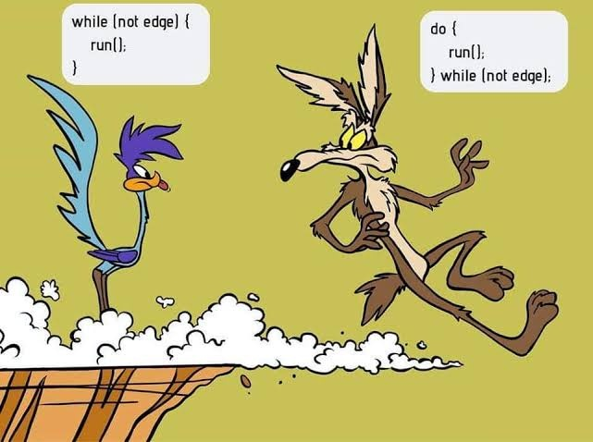

Slide 32
Questions?

